Slide 1
Data Mining Task Primitives
A data mining query is defined in terms of data mining task primitives.

Slide 2
Task Primitives Specifies
The set of task-relevant data to be mined
The kind of knowledge to be mined:
The background knowledge to be used in the discovery process
The interestingness measures and thresholds for pattern evaluation
The expected representation for visualizing the discovered patterns

Slide 3
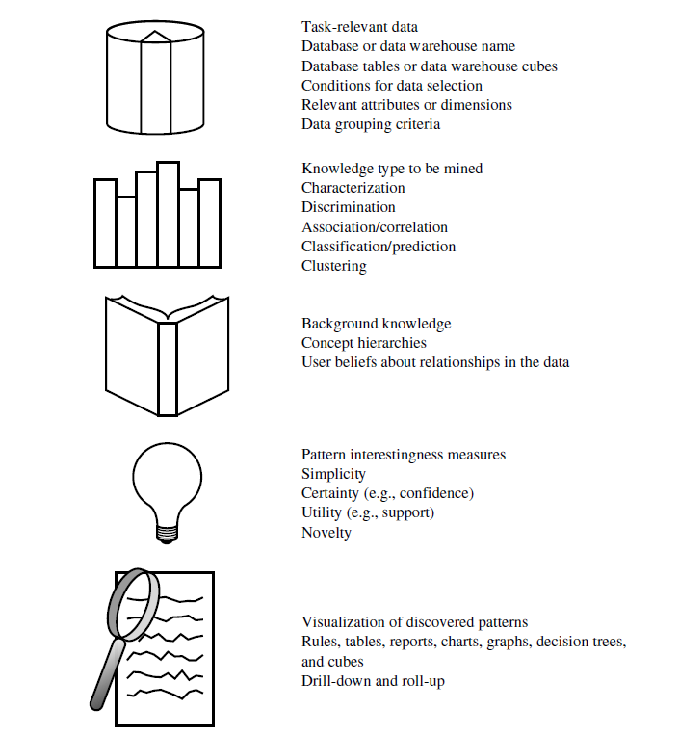

Slide 4
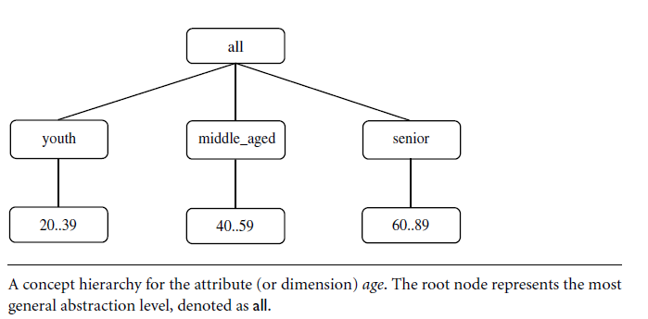

Slide 5
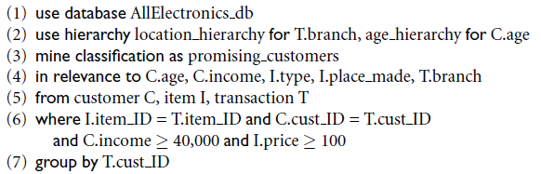

Data Mining Classification Rules

